Slide 1
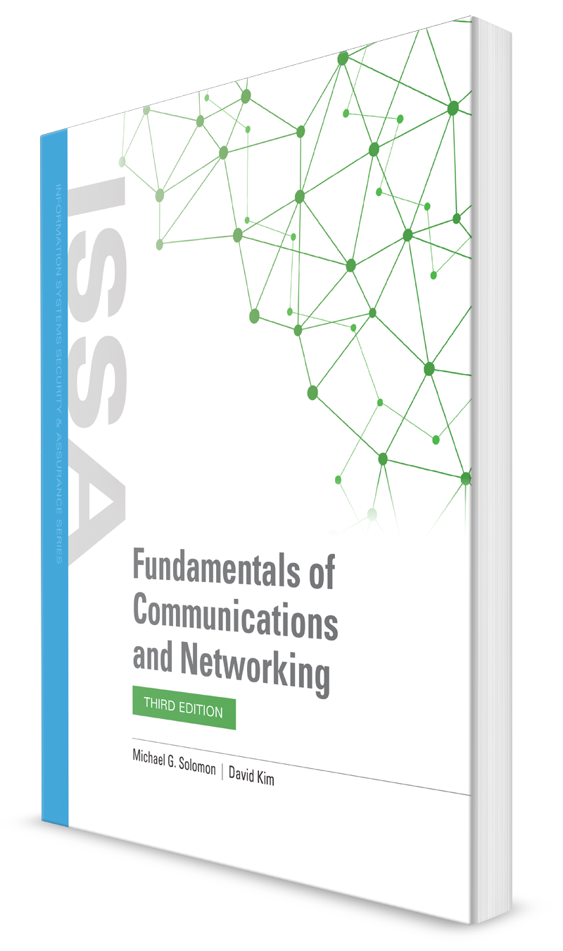
The Physical and Data Link Layers
CHAPTER 4

Slide 2
Learning Objective(s) and Key Concepts
Learning Objective(s)
Key Concepts
Differentiate between the standards, specifications, technologies, and infrastructure that drive current LAN connectivity.
The IEEE 802.3 standard and specifications
The Physical Layer and Data Link Layer
Structured wiring and internetworking Ethernet LANs
Designing Ethernet networks for workgroups, buildings, campuses, and metropolitan area networks
GigE and 10 GigE specifications, and backbone trunking

Slide 3
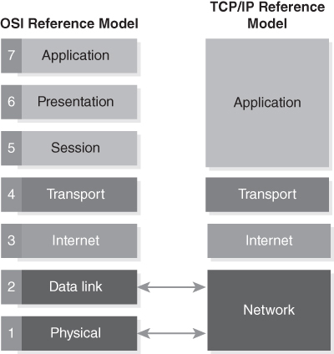
Physical Layer and Data Link Layer
Physical Layer
Where the signaling of 1’s and 0’s occurs
Where cabling and other transmission media is needed to transit them
Data Link Layer
Defines the frame format that the 1’s and 0’s are to follow
FIGURE 4-1 OSI model compared to TCP/IP model.

Slide 4
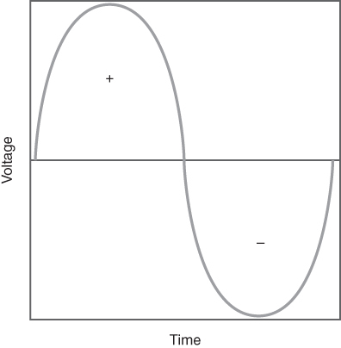
OSI Model Compared to TCP/ IP Model
FIGURE 4-2 A sine wave.

Slide 5
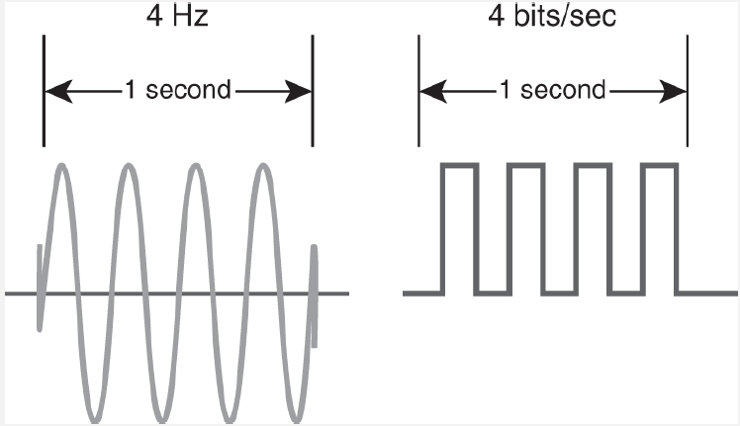
Frequency vs bps

Slide 6
Physical Layer: OSI Layer 1
Operates at the bottom layer (Layer 1) of the Open Systems Interconnection (OSI) Reference Model
Reliability is the availability and integrity of the data transmission
Availability refers to uptime—whether there is physical link access to the communication line
Integrity refers to whether the data (the 1’s and 0’s) made it to the destination intact and accurate
Transmission medium can be air (radio frequency), metal (copper unshielded twisted-pair, shielded twisted-pair, or coaxial cable), or glass (optical fiber)
Notes:
Troubleshoot from bottom up
critical

Slide 7
Transmission Media
Copper
Used in unshielded twisted-pair (UTP) and shielded twisted-pair (STP) cable
UTP is most common in office buildings and wired network environments
Coaxial
Rugged indoor or outdoor cable
Cable TV infrastructure is supported by coaxial cable to the residence
Glass/fiber
Fiber cables have a glass core surrounded by a glass cladding; light travels through glass core
Fiber optics can support large amounts of data transmissions over very far distances; often used for long-haul data transmissions

Slide 8
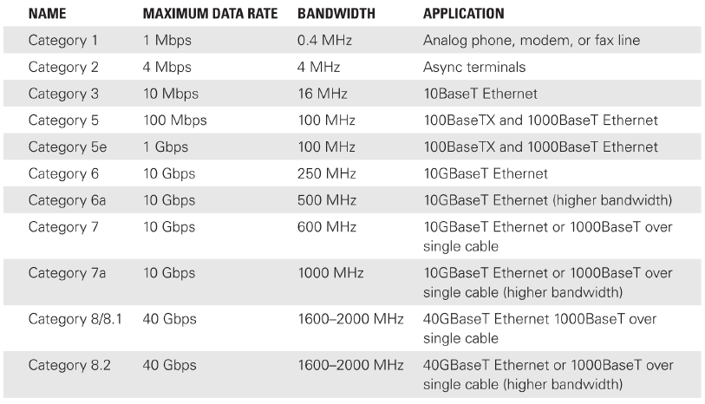
Transmission Media
Notes:
100BaseTX is a type of standard for implementing Fast Ethernet networks
Copper = each level represents a level of bandwidth

Slide 9
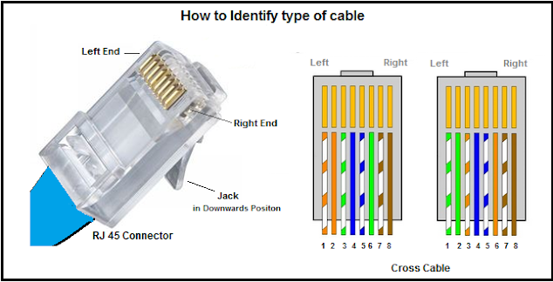
Twisted Pair Cable
Notes:
8 pairs of wires

Slide 10
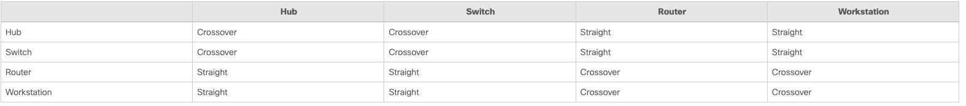
Twisted Pair Cable
Notes:
Crossover – straightthrough
Depending on how the wires are twisted (colors)

Slide 11
Single Mode vs Multimode Fiber Cable
In optical fiber technology, single mode fiber (SMF) or monomode fiber, is an optical fiber that is designed for the transmission of a single ray or mode of light as a carrier to propagate at a time
Advantages of Single Mode Fiber
Single mode fiber distance: single mode fiber supports a greater distance than multimode fiber because of its lower attenuation.
For example, multimode fiber generally has a reach of several hundred meters, whereas SM fiber has the potential to reach 200 km.
Bandwidth capacity: A single mode optical fiber cable offers a higher bandwidth than a multimode fiber optic cable.
Data dispersion: single mode fiber only transmits light of one mode, causing no modal dispersion.
Single mode fiber speed: Single mode fiber doesn’t have modal dispersion, modal noise, and other effects that come with multimode transmission.
So it can carry signals at much higher speeds and up to 50 times more distance than multimode fiber.
Notes:
Single = yellow – 10g
Multi= orange – 1g
Fiber cuts = outages, fragile and takes long to repair

Slide 12
Single Mode vs Multimode Fiber Cable
Disadvantages of Single Mode Fiber
Requires much tighter tolerances: it is difficult to couple light into a single mode fiber than into a multimode fiber because of the smaller fiber core diameter inside the SMF.
The smaller cores (8-10 µm) require much tighter tolerances than coupling light into the larger cores (62.5/50 µm) of multimode fibers.
Costs more: single mode fiber components and equipment are more expensive than that of multimode fiber.
Multimode fiber can support multiple light modes, its price is higher than single mode fiber.
However, on the device side, single mode fiber devices are more expensive than multimode fiber devices because single mode fiber typically uses solid-state laser diodes.
Stricter technology: it is more difficult to manufacture and handle SMFs than MMFs.

Slide 13
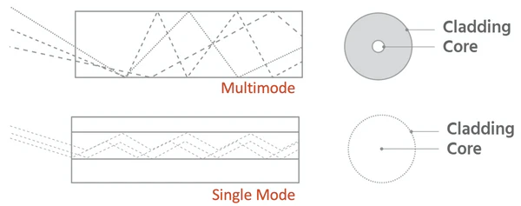
Single Mode vs Multimode Fiber Cable

Slide 14
Structured Wiring System
Is a modular cabling solution that is flexible
Includes both outside cabling and indoor cabling
Has the following parts:
Workstation outlet and RJ-45 connections
Intermediate distribution frame (IDF) or wiring closet
Intrabuilding distribution
Main distribution frame (MDF) or data center
Campus or building backbone distribution
Notes:
Workstation outlet and RJ-45 connections—The termination point at the desktop location where twisted-pair cabling is connected to an 8-pin, modular RJ-45 connector
Intermediate distribution frame (IDF) or wiring closet—The location or room where building backbone cabling terminates to provide connectivity to desktop locations
Intrabuilding distribution—The cabling that typically emanates from a main distribution frame (MDF) or data center facility to an intermediate distribution frame (IDF) or wiring closets
Main distribution frame (MDF) or data center—The location or room where backbone cabling terminates to provide connectivity to the data center facility
Campus or building backbone distribution—The inter-building cabling that typically consists of fiber optic backbone cabling and twisted-pair bundled cabling to support 10-20+ years of connectivity for a campus or within a building

Slide 15
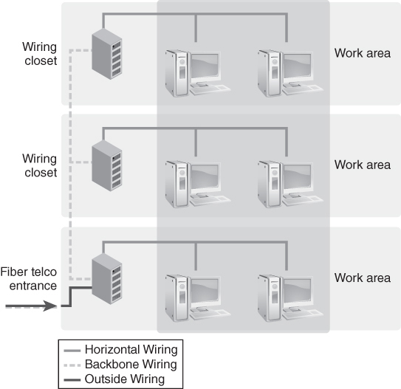
Example of a Structured Wiring System
FIGURE 4-9 An example of a structured wiring system.

Slide 16
Data Link Layer: OSI Layer 2
Think of Data Link Layer as the physical envelope (frame format) that you put the letter in, where the letter is composed of a series of 1’s and 0’s
Frame format
Is based on 8 bits or 1 octet, also known as a byte
Is what defines the structure of the 1’s and 0’s being transmitted
Data Link Layer prepares data to be placed onto the physical link
Sublayers
Logical Link Control (LLC)
Media Access Control (MAC)

Slide 17
Media Access Control (MAC)
The MAC sublayer controls access to the media.
This is where the Ethernet transceiver operates and interfaces with the Physical Layer.
This sublayer listens to the network, and transmits or receives Ethernet frames onto the physical network
This listening is the carrier sense of carrier sense multiple access with collision detection
(CSMA/CD).

Slide 18
Logical Link Control (LLC)
The LLC sublayer controls linking logically.
The LLC sublayer sits above the MAC sublayer and acts like a traffic cop, organizing the upper layer protocols into their MAC layer frame prior to transmission onto the network.
Think of the LLC sublayer as the flow and error control traffic cop.
It allows multipoint communications over a computer network.

Slide 19
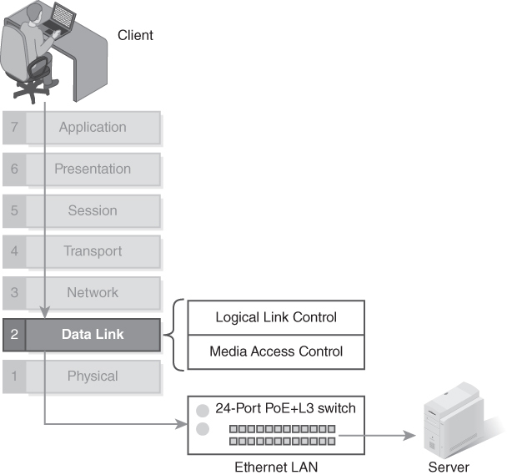
The Data Link Layer and its Sublayers
FIGURE 4-11 The Data Link Layer and its sublayers.
Notes:
Media Access Control (MAC)—The MAC sublayer controls access to the media. This is where the Ethernet transceiver operates and interfaces with the Physical Layer. This sublayer listens to the network, and transmits or receives Ethernet frames onto the physical network. This listening is the carrier sense of multiple access with collision detection (CSMA/CD). This will be discussed further in the next section.
Logical Link Control (LLC)—The LLC sublayer controls linking logically. The LLC sublayer sits above the MAC sublayer and acts like a traffic cop, organizing the upper layer protocols into their MAC layer frame prior to transmission onto the network. Think of the LLC sublayer as the flow and error control traffic cop. It allows multipoint communications over a computer network.

Slide 20
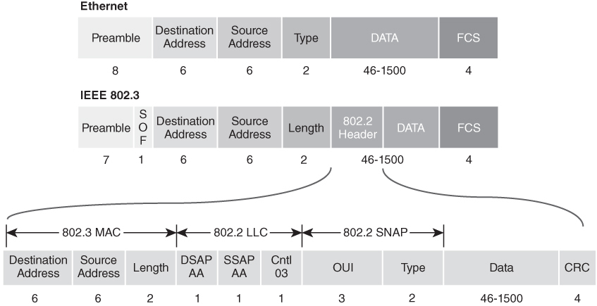
Ethernet and IEEE 802.3 Frame Formats
FIGURE 4-12 Ethernet II and IEEE 802.3 frame formats.
Notes:
Each ethernet packet is 1500 bytes
Fcs = frame check sequence, checks integrity of data

Slide 21
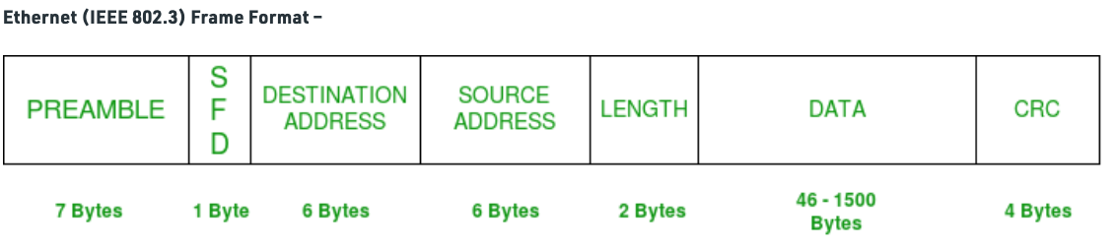
IEEE 802.3 Frame Format

Slide 22
IEEE 802.3 Frame Format
PREAMBLE – Ethernet frame starts with 7-Bytes Preamble.
This is a pattern of alternative 0’s and 1’s which indicates starting of the frame and allow sender and receiver to establish bit synchronization.
Initially, PRE (Preamble) was introduced to allow for the loss of a few bits due to signal delays.
But today’s high-speed Ethernet don’t need Preamble to protect the frame bits.
PRE (Preamble) indicates the receiver that frame is coming and allow the receiver to lock onto the data stream before the actual frame begins.

Slide 23
IEEE 802.3 Frame Format
Start of frame delimiter (SFD) – This is a 1-Byte field which is always set to 10101011.
SFD indicates that upcoming bits are starting of the frame, which is the destination address.
Sometimes SFD is considered the part of PRE, this is the reason Preamble is described as 8 Bytes in many places.
The SFD warns station or stations that this is the last chance for synchronization.
Destination Address – This is 6-Byte field which contains the MAC address of machine for which data is destined.
Source Address – This is a 6-Byte field which contains the MAC address of source machine.
As Source Address is always an individual address (Unicast), the least significant bit of first byte is always 0.

Slide 24
IEEE 802.3 Frame Format
Length – Length is a 2-Byte field, which indicates the length of entire Ethernet frame.
This 16-bit field can hold the length value between 0 to 65534, but length cannot be larger than 1500 because of some own limitations of Ethernet.
Data – This is the place where actual data is inserted, also known as Payload.
Both IP header and data will be inserted here if Internet Protocol is used over Ethernet.
The maximum data present may be as long as 1500 Bytes.
In case data length is less than minimum length i.e. 46 bytes, then padding 0’s is added to meet the minimum possible length.

Slide 25
IEEE 802.3 Frame Format
Cyclic Redundancy Check (CRC) – CRC is 4 Byte field.
This field contains a 32-bits hash code of data, which is generated over the Destination Address, Source Address, Length, and Data field.
If the checksum computed by destination is not the same as sent checksum value, data received is corrupted.

Slide 26
Extended Ethernet Frame
DA [Destination MAC Address] : 6 bytes SA [Source MAC Address] : 6 bytes Type [0x8870 (Ethertype)] : 2 bytes DSAP [802.2 Destination Service Access Point] : 1 byte
The Destination Service Access Point (DSAP) is an eight-bit field that allows the LLC layer to keep track of multiple connections across an IEEE 802 LAN environment
SSAP [802.2 Source Service Access Point] : 1 byte
See DSAP but for source
Ctrl [802.2 Control Field] : 1 byte
Data [Protocol Data] : > 46 bytes
FCS [Frame Checksum] : 4 bytes
802.2SNAP – Vendor private protocol identifiers

Slide 27
Ethernet Evolution
10Base5 “Thicknet” evolved into 10Base2 “Thinnet”
Transition to structured wiring systems drove:
10Base-T, 100Base-TX, and 1000Base-T (GigE) to the desktop
Transition to structured wiring systems drove:
10GBase-T (10 GigE), 25GBase-T (25 GigE), 40GBase-T (40 GigE), and 100GBase-T (100 GigE) for server farm connectivity
Notes:
Higher speeds allow for real-time applications and time-sensitive protocols

Slide 28
IEEE 802.3 Standards and Specifications: Solving Business Challenges (1 of 2)
Business Challenge | Business Solution | Technical Solution
Need to connect PCs, workstations, and servers | Interconnect the PCs, workstations, and servers on the same physical and logical network | Ethernet switch connectivity via star-wired, unshielded twisted-pair cabling
Need to share and access applications with other workers | Install shared applications on servers for all users to access | Implement LAN servers with enterprise-wide access controls
Need to share files between workers | Implement user and shared permission rights for access to drives, folders, and data | Implement standardized access controls and permission rights as per policy definition
Need to share printers and other devices among multiple users | Allow users to access shared servers and printers | Integrate office automation functionality within departments and workgroups
Notes:
Technology driven by business needs

Slide 29
IEEE 802.3 Standards and Specifications: Solving Business Challenges (2 of 2)
Business Challenge | Business Solution | Technical Solution
Need to communicate with other workers throughout the company | Support multiple methods of communicating between users—VoIP, email, IM chat, conferencing, and collaboration | Enable VoIP, SIP, and unified communication solutions for user desktops and mobile devices
Need for faster network speeds and increased connectivity to allow distributed applications and worldwide collaboration | Support applications such as multimedia (a combination of voice, data, imaging, and video) | Enable applications, including desktop video conferencing, video on demand, and transmission of video images, such as for medical diagnosis
Need for faster backbone networking speeds for MANs and data center backbone connections | Support high-speed LAN connections in the MAN and data center | Enable data backup and recovery solutions and disaster recovery backup network connections, and extend the LAN within a MAN

Slide 30
Some IEEE 802.3 CSMA/CD Standards
Ethernet Standard | Release Date | Description
802.3 | 1983 | (10Base5) 10 Mbps using thick coaxial cable
802.3ab | 1999 | (1000Base-T) 1 Gbps using twisted-pair cable
802.3an | 2006 | (10GBase-T) 10 Gbps using twisted-pair cable
802.3ba | 2010 | 40 Gbps and 100 Gbps to support both endpoint and link aggregation over single-mode fiber
802.3cg | 2019 | 10Base-T equivalent 10 Mbps network to support transmit and receive signaling over a single pair of unshielded twisted-pair cabling

Slide 31
How Multiple Nodes Share Network Media
Carrier sense
Multiple access
Collision detection
CSMA/CD
Notes:
Carrier sense—NIC cards listen on the physical media for specific voltage levels or carrier signals. If the coast is clear, the NIC can transmit on the network. If someone is already transmitting, you will know because the carrier sense voltage level is different.
Multiple access—NIC cards can transmit simultaneously. When this occurs, it causes a collision situation on the physical media. This collision is noticed by the NIC card transceivers that listen to specific voltage levels or carrier signals.
Collision detection—NIC cards react to signal collisions by retransmitting after receiving notification that a collision occurred. Although this solution solves the problem caused by the initial collision, bus topologies with excessive collisions also can cause problems.

Slide 32
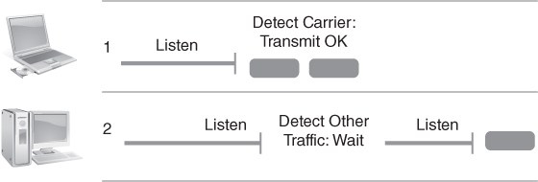
Ethernet Carrier Sense Multiple Access
FIGURE 4-15 Ethernet carrier sense multiple access.

Slide 33
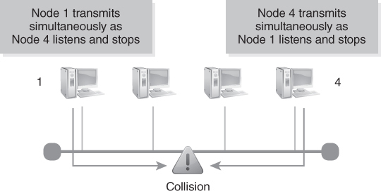
Ethernet Collision Detection
FIGURE 4-16 Ethernet collision detection.

Slide 34
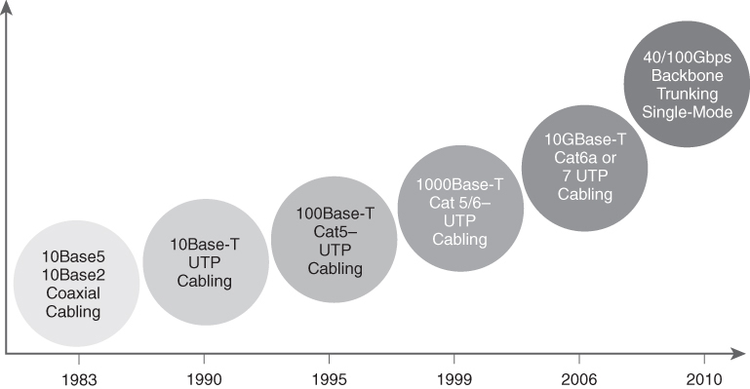
Ethernet Technology Bandwidth Speed Evolution
FIGURE 4-17 Ethernet technology bandwidth speed evolution.

Slide 35
Internetworking LANs: Bridging Versus Routing (1 of 2)
Reasons to separate and internetwork LANs: Security, traffic segmentation, and ease of network management
Server access and maximizing performance are key considerations when designing LANs
Where you put servers can impact how you design network
Need for high-speed backbone connectivity from data center to desktop location is paramount
How Layer 2 and Layer 3 networking can achieve that is main objective of internetworking

Slide 36
Internetworking LANs: Bridging Versus Routing (2 of 2)
Repeaters and hubs—Layer 1 forwarding
Bridges and switches—Layer 2 forwarding
Routers—Layer 3 routing

Slide 37
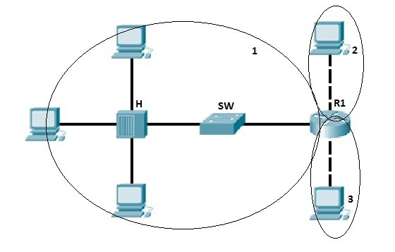
Broadcast Domain
A broadcast domain is the domain in which a broadcast is forwarded.
A broadcast domain contains all devices that can reach each other at the data link layer (OSI layer 2) by using broadcast.
All ports on a hub or a switch are by default in the same broadcast domain.
All ports on a router are in the different broadcast domains and routers don’t forward broadcasts from one broadcast domain to another.
Notes:
In the picture above we have three broadcast domains, since all ports on a hub or a switch are in the same broadcast domain, and all ports on a router are in a different broadcast domain.

Slide 38
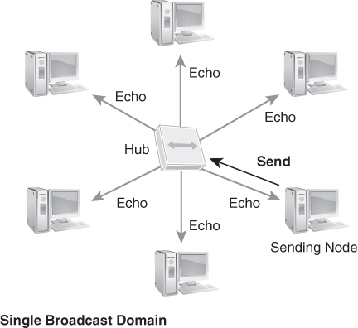
LAN Hub Single Broadcast Domain
FIGURE 4-18 LAN hub single broadcast domain.

Slide 39
Collision Domain
A collision domain is, as the name implies, the part of a network where packet collisions can occur.
A collision occurs when two devices send a packet at the same time on the shared network segment.
The packets collide and both devices must send the packets again, which reduces network efficiency.
Collisions are often in a hub environment, because each port on a hub is in the same collision domain.
By contrast, each port on a bridge, a switch or a router is in a separate collision domain.

Slide 40
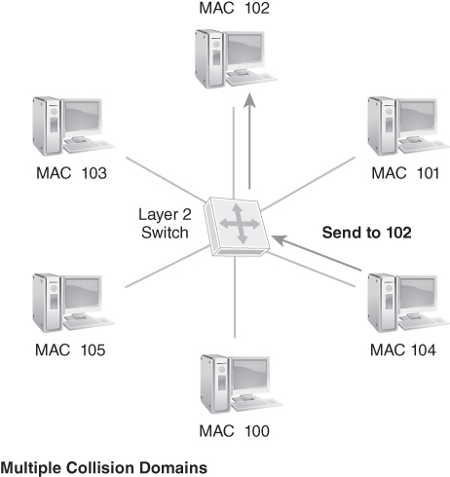
Multiple Collision Domains with a Layer 2 Switch
FIGURE 4-19 Multiple collision domains with a Layer 2 switch.

Slide 41
Ethernet Network Design Fundamentals (1 of 2)
Edge networks—The desktop workstation LAN connection
Building backbone networks—Aggregations of edge network switches into a collapsed backbone within that building
Campus backbone networks—Campus backbone networks are aggregations of multiple buildings on the same physical campus
Metropolitan area networks (MANs)—Aggregations of remote buildings, but within a regional MAN service area (usually provided by a metro Ethernet service provider)
Wide area backbone networks—Cloud-based wide area network infrastructures such as Multiprotocol Label Switching (MPLS) for wide area IP network connectivity

Slide 42
Ethernet Network Design Fundamentals (2 of 2)
Port density
Power over Ethernet (PoE)
Layer 2 versus Layer 3 edge switch
Layer 2 and Layer 3 resiliency and redundancy
Layer 2 and Layer 3 trunking
Switch architecture
Switch security
Notes:
Port density—Organizations need high port densities to ensure the lowest cost of connectivity.
Power over Ethernet (PoE)—Supports IP phones for VoIP and other network-connected devices that may require electrical power distribution.
Layer 2 versus Layer 3 edge switch—Depends upon network traffic requirements and whether real-time applications and time-sensitive protocols are required.
Layer 2 and Layer 3 resiliency and redundancy—Requirements should be driven by real-time applications and whether subsecond failover is required.
Layer 2 and Layer 3 trunking—Backbone trunking, load-balancing, and use of 100 Gbps Ethernet LAN trunks may be required, especially if access to server farms and real-time applications is required.
Switch architecture—Use of ASIC; high-speed, backplane architectures; dual processors; and LAN switching should be assessed.
Switch security—Use of MAC layer address filtering, Simple Network Management Protocol (SNMP) monitoring and alarming, security lockdowns, and other layered security controls should be implemented to ensure confidentiality, integrity, and availability.

Slide 43
Cut through or Store and forward?
Cut through switching
When switches receive the frame, it will look up its first 6 bytes of the frame that following the preamble.
Then the LAN switch will check the destination MAC address in its switching table, and determine the outgoing interface port, and forwards the frame to its destination.
No CRC error-checking in cut-through switching process.
Therefore, frames with and without errors will be forwarded to the receiving switches.
And error-check process needs to be carried out by the receiving device to ensure error-free transmission.
To improve this situation, fragment free switching is applied to compensate for the drawbacks of cut-through switching, which will discard frames that smaller than 64 bytes in length and reduce late collisions in data transmission.

Slide 44
Cut through or Store and forward?
Store-and-forward switching will wait until the entire frame has arrived before forwarding it.
Then the LAN switch will store each complete frame into switch memory buffers and check errors before making a forwarding decision.
CRC (cyclic redundancy check) which uses a mathematical formula based on the number of bits (1s) in the frame to check the received frame.
If no errors are present, the frame will be forwarded to the destination address. Otherwise the corrupted frame will be discarded.
This process ensures high level of error-free network traffic, because the destination network will not be affected by the corrupted frames.

Slide 45
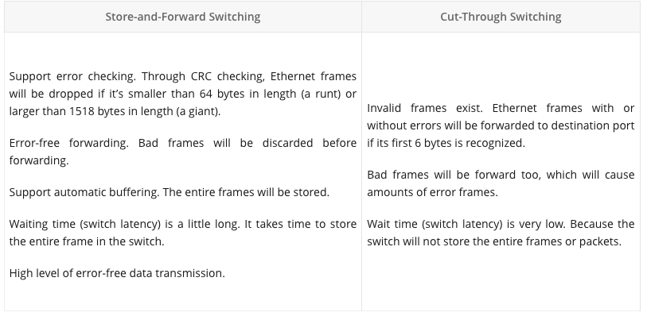
Cut through or Store and forward?

Slide 46
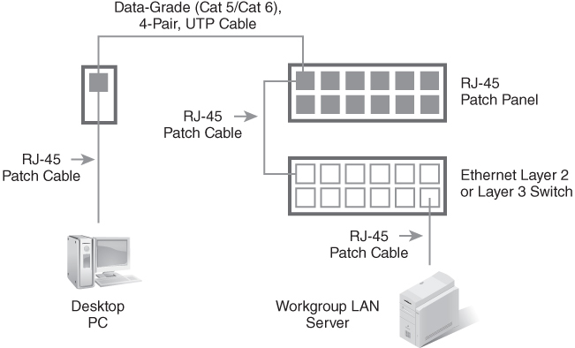
Edge Network: Workgroup LAN Connection to the Desktop
FIGURE 4-20 Workgroup LAN connection to the desktop.

Slide 47
Workgroups
Workgroups typically need to share data and information, and it makes sense to be able to do this within their own workgroup LAN
The term workgroup refers to a group of users and their devices that are needed to perform their job functions.
Used to be a Microsoft term for resources to be shared across the same LAN (pre–Active Directory days)

Slide 48
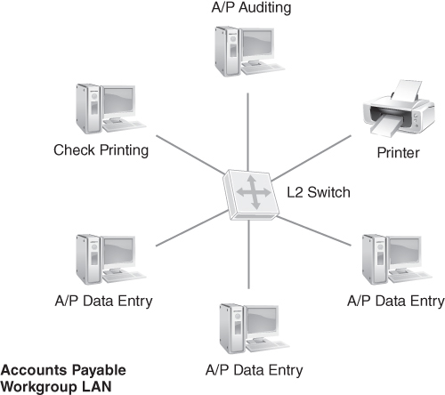
Edge Network: Workgroup LAN (Also known as Access Layer)
FIGURE 4-21 Workgroup LAN.
Modified from Copyright study-ccna.com 2020. All rights reserved.

Slide 49
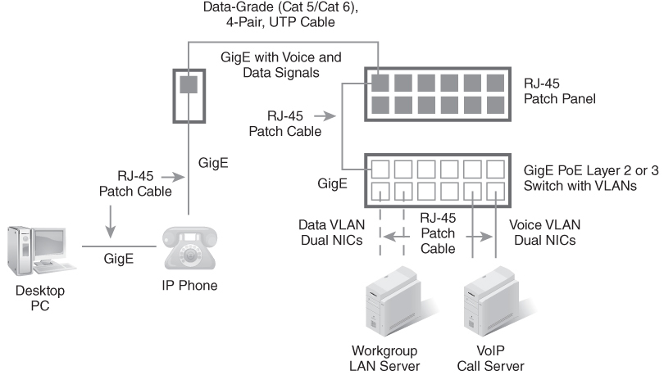
Edge Network: Use of PoE Switches
FIGURE 4-22 PoE LAN switches.
Data from National Institute of Standards and Technology.

Slide 50
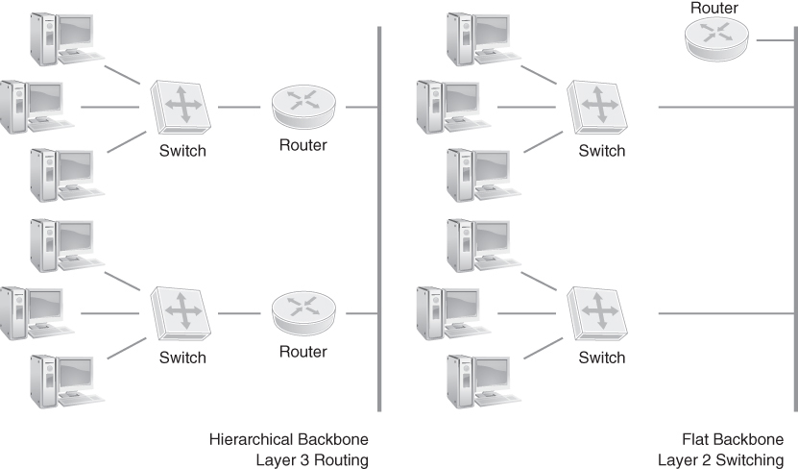
Edge Network: Departmental LAN
FIGURE 4-23 Departmental backbone LAN topologies.

Slide 51
Switched LAN aggregation
Edge switches require a high-speed backbone trunk connection.
Load-balancing, redundancy, and sub-second failover are all requirements for backbone network connectivity.
Workgroup file servers housed in data centers require high-speed backbone connectivity.
802.1Q Vlan - where needed

Slide 52
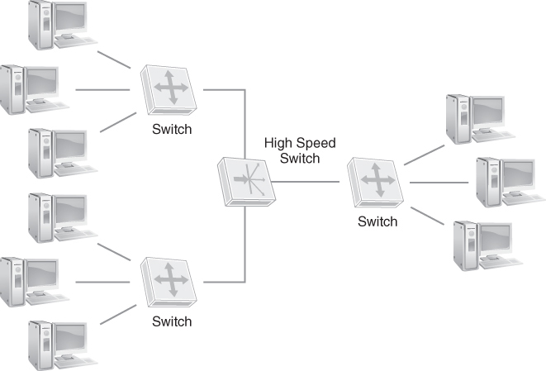
Building Backbone: Collapsed Backbones
FIGURE 4-24 Collapsed building backbone network.
Notes:
LANs that cover entire buildings and span multiple departments often utilize the star-wired fiber optic cabling for connectivity to a common Ethernet switch or router.
The backplane of the high-speed switch provides high-speed connectivity for 10/100/1,000/4,000/10,000 Mbps Ethernet LAN connections.
This topology is called a collapsed backbone (also known as a backbone-in-a-box or inverted backbone).
A collapsed backbone minimizes traffic flowing between departmental LANs given that they can transfer frames and packets at high speeds on a common backplane.
Switch in the middle is part of the Distribution Layer

Slide 53
3 Tier Architecture
Access network
Workgroup LAN supporting PC and workstation connectivity
Distribution network
Building backbone network that connects workgroup LANs into department LANs
Core backbone network
High-speed backbone network that connects building backbones and departmental LANs into a common and shared network.
This can be a metro Ethernet MAN, a campus backbone network, or a building backbone network.

Slide 54
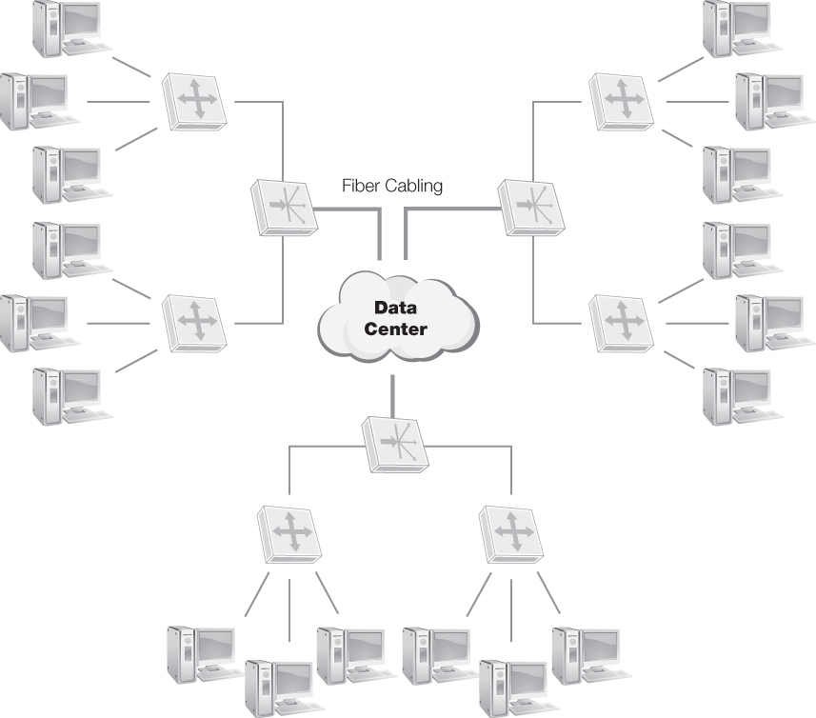
Campus Backbone: Collapsed Data Center Backbone
FIGURE 4-25 Collapsed campus backbone network.
Notes:
Like building collapsed backbone, campus collapsed backbone creates even bigger networks.
A collection of central switches that connect multiple building collapsed backbones can create an organizational campus network while retaining the separation of each workgroup, department, and building.
Common network connection levels are:
Edge network—Workgroup LAN supporting PC and workstation connectivity
Distribution network—Building backbone network that connects workgroup LANs into department LANs
Core backbone network—High-speed backbone network that connects building backbones and departmental LANs into a common and shared network. This can be a metro Ethernet MAN, a campus backbone network, or a building backbone network.

Slide 55
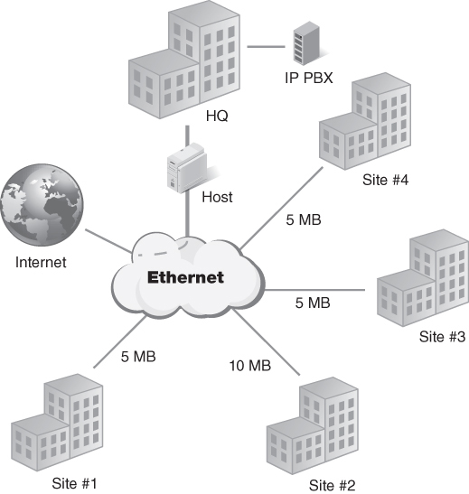
Metropolitan Area Backbone: Metro Ethernet Backbone
FIGURE 4-26 Metro Ethernet backbone network.
ForeScout.com
Notes:
Service providers can use existing single-mode fiber optic cabling to extend the physical distance of Ethernet LAN connections
Metropolitan area networks are supported by carrier backbone networks capable of supporting Ethernet LAN connections

Slide 56
GigE and 10 GigE Specifications
Ethernet running at 1 Gbps is also called GigE
Ethernet running at 10 Gbps (10 times faster) is also called10 GigE
Current, most common versions of Ethernet are 100 Mbps and GigE
10 GigE is becoming a standard for LANs

Slide 57
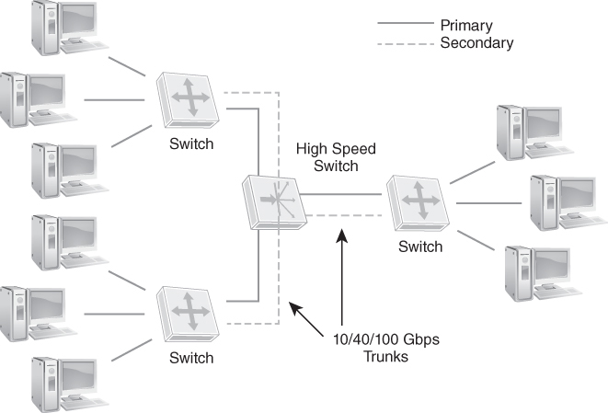
25, 40, and 100 GigE: Server Farms and Backbone Trunking
FIGURE 4-27 Server farm and backbone trunking.
ForeScout.com.
Notes:
Organizations utilize both multimode and single-mode fiber optic cabling.
With single-mode fiber optics, 25, 40, and 100 Gbps Ethernet backbone trunking is possible.
Aggregating 10 GigE backbone connections and interconnecting Ethernet LAN switches with 25, 40, or 100 Gbps trunks provides both a resilient and high-speed backbone connection.

Slide 58
Summary
The IEEE 802.3 standard and specifications
The Physical Layer and Data Link Layer
Structured wiring and internetworking Ethernet LANs
Designing Ethernet networks for workgroups, buildings, campuses, and metropolitan area networks
GigE and 10 GigE specifications, and backbone trunking

